Slide 1

VIRTUAL INTELLIGENCE SERVICE
VICTORIA PER INTELLECTUM
SYRIAN AIRFORCE
INTREP VIS-OPAR-003
DRAFT
DISCLAIMER:
This is for multiplayer online gaming using the Digital Combat Systems simulation software published by Eagle Dynamics. The information is not in any way suitable for real world use or operations.
Version: X.X
Published: YYYY-MM-DD

Slide 2
INTRODUCTION
A
A
Aim:
This report intends to present information on the Syrian Airforce, Squadron locations and information about their capability.
Reference:
- INTREP VIS B-002 Generic Air Force Structure v1.0
- INTREP VIS OPAR-002 - Syrian IADS
Content:
B
B
C
C
D
D
E
E
F
F

Slide 3
Doctrine
Syr AF doctrine
A
A
B
B
C
C
D
D
E
E
F
F
Back

Slide 4
Command and Control
Syr AF doctrine
A
A
B
B
C
C
D
D
E
E
F
F
Back

Slide 5
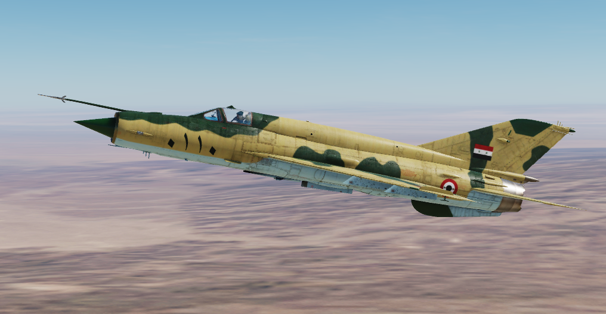
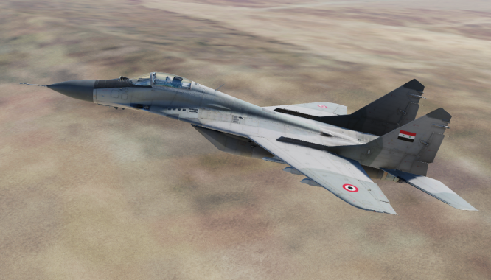
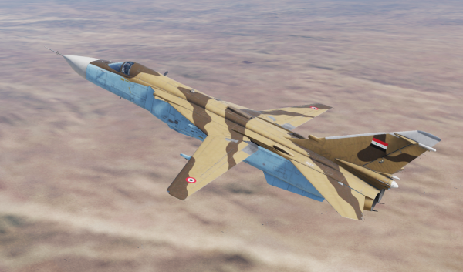
Mission type capability
Fighter squadrons conduct the following mission sets:
- Sweep,
CAP
Escort.
Interceptor squadrons are based at airfields and tied to Syrian IADS and supports as Quick Reaction Alert flights to protect Syrian airfields from attack.
Assault Aviation squadrons conduct the following mission sets:
CAS
AR
AI
Bomber Squadrons conduct the following mission sets:
AI
Strikes
A
A
B
B
C
C
D
D
E
E
F
F
Back

Slide 6
Organization
SYR AF
60th Air Division
A-A role
70th Air Divison
A-G role
80th Support Division
Support role
1st Fighter Aviation Regiment (MiG-29)
2nd Fighter Aviation Regiment (MiG-21)
3rd Interceptor Aviation Regiment (MiG-25)
621st Interceptor Squadron
622nd Interceptor Squadron
611th Fighter Squadron
612th Fighter Squadron
613th Fighter Squadron
601st Fighter Squadron
602nd Fighter Squadron
603rd Fighter Squadron
A
A
B
B
C
C
D
D
E
E
F
F
Back

Slide 7
Organization
SYR AF
60th Air Division
A-A role
70th Air Divison
A-G role
80th Support Division
Support role
1st Fighter Aviation Regiment (MiG-29)
2nd Fighter Aviation Regiment (MiG-21)
3rd Interceptor Aviation Regiment (MiG-25)
621st Interceptor Squadron
622nd Interceptor Squadron
611th Fighter Squadron
612th Fighter Squadron
613th Fighter Squadron
601st Fighter Squadron
602nd Fighter Squadron
603rd Fighter Squadron
N
= Night capable
A
A
Exp
= Experienced
A
= Attack (A-G)
B
B
F/A
= Fighter+Attack
(A-A + A-G)
C
C
D
D
E
E
F
F
Night
Exp
Exp
Night
Exp
Night
Exp
Back

Slide 8
Organization
SYR AF
60th Air Division
A-A role
70th Air Divison
A-G role
80th Support Division
Support role
4th Figher Aviation Regiment (MiG-23)
5th Assault Aviation Regiment (MiG-29)
6th Assault Aviation Regiment (MiG-29)
7th Bomber Regiment (SU-24)
8th Interceptor Regiment (MiG-21)
701st Fighter Squadron
702nd Fighter Squadron
711th Assault Aviation Squadron
712th Assault Aviation Squadron
721st Assault Aviation Squadron
722nd Assault Aviation Squadron
731st Bomber Squadron
732nd Bomber Squadron
741st Interceptor Squadron
742nd Interceptor Squadron
A
A
B
B
C
C
D
D
E
E
F
F
Back

Slide 9
Organization
SYR AF
60th Air Division
A-A role
70th Air Divison
A-G role
80th Support Division
Support role
4th Figher Aviation Regiment (MiG-23)
5th Assault Aviation Regiment (MiG-29)
6th Assault Aviation Regiment (MiG-29)
7th Bomber Regiment (SU-24)
8th Interceptor Regiment (MiG-21)
701st Fighter Squadron
702nd Fighter Squadron
711th Assault Aviation Squadron
712th Assault Aviation Squadron
721st Assault Aviation Squadron
722nd Assault Aviation Squadron
731st Bomber Squadron
732nd Bomber Squadron
741st Interceptor Squadron
742nd Interceptor Squadron
N
= Night capable
A
A
Exp
= Experienced
A
= Attack (A-G)
B
B
F/A
= Fighter+Attack
(A-A + A-G)
C
C
D
D
E
E
F
F
Night
Exp
Night
F/A
Exp
A
Night
Exp
Night
F/A
A
Back

Slide 10
Organization
SYR AF
60th Air Division
A-A role
70th Air Divison
A-G role
80th Support Division
Support role
9th Transport Aviation Regiment
811th Transport Squadron (YAK-40)
801st Transport Squadron (IL76)
802nd Transport Squadron (AN-26B)
A
A
B
B
C
C
D
D
E
E
F
F
Back

Slide 11
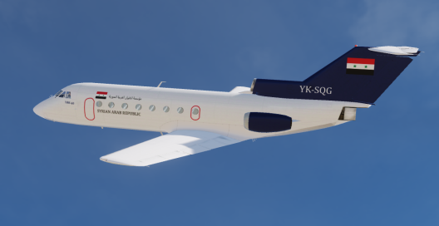
Organization
SYR AF
60th Air Division
A-A role
70th Air Divison
A-G role
80th Support Division
Support role
9th Transport Aviation Regiment
811th Transport Squadron (YAK-40)
801st Transport Squadron (IL76)
802nd Transport Squadron (AN-26B)
N
= Night capable
A
A
Exp
= Experienced
A
= Attack (A-G)
B
B
F/A
= Fighter+Attack
(A-A + A-G)
C
C
D
D
E
E
Exp
F
F
Night
Back

Slide 12
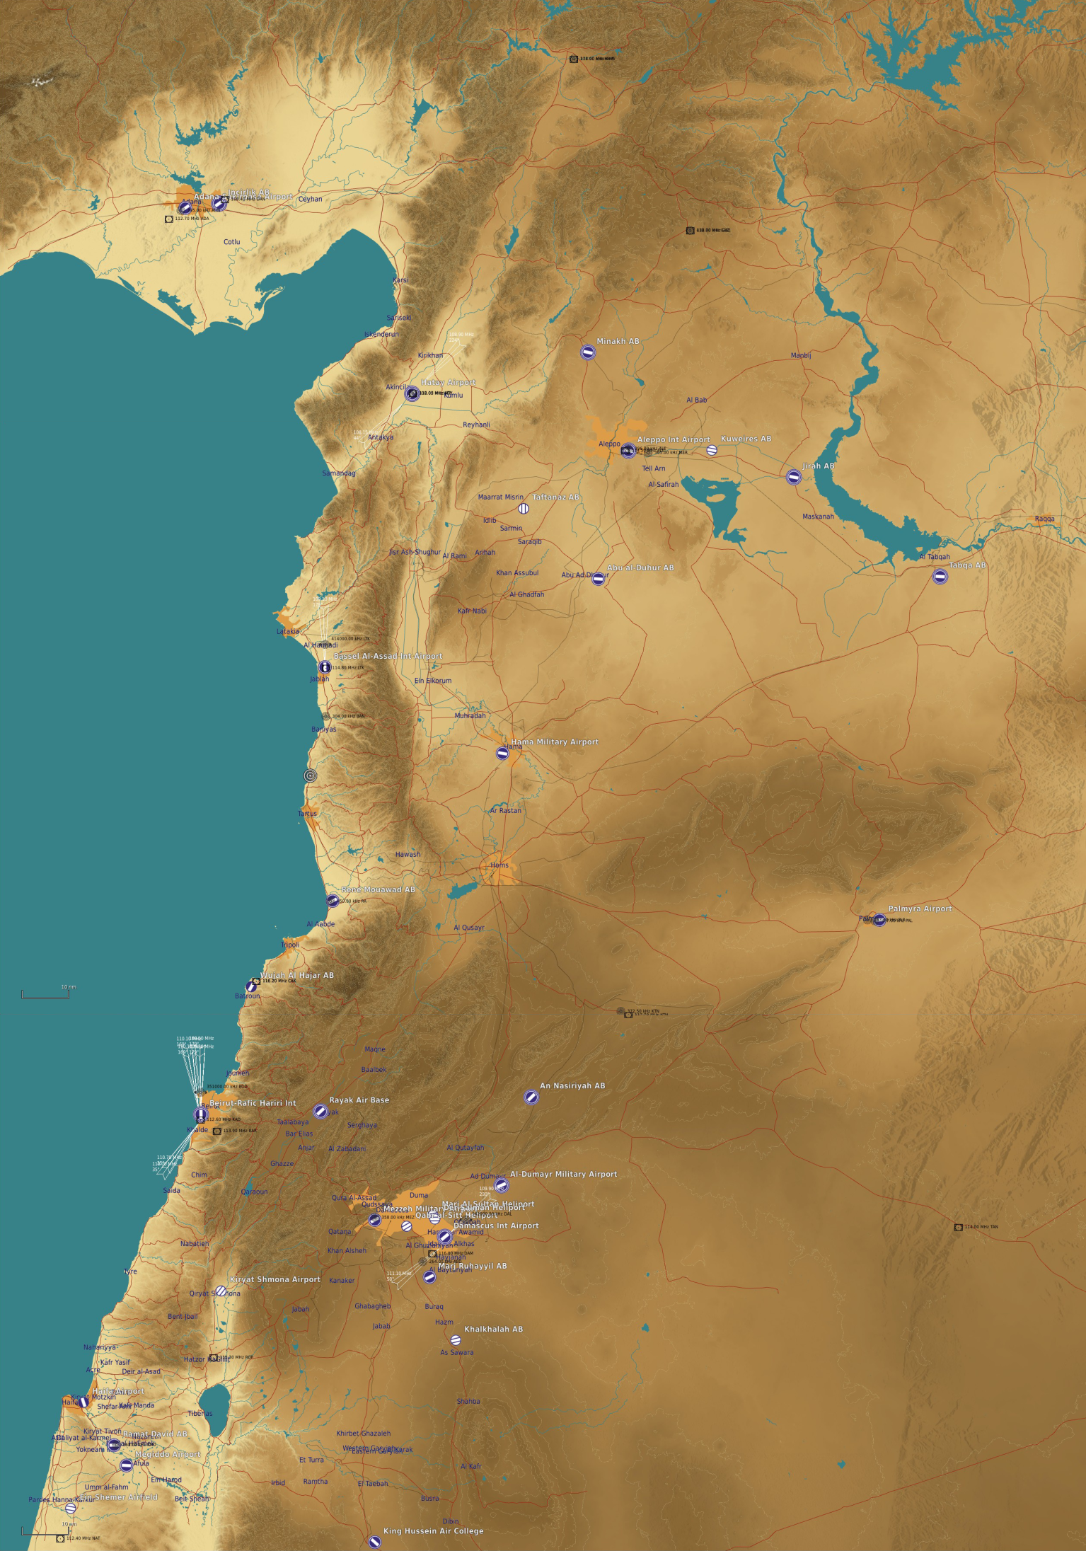
Squadron locations
LEGEND:
MINHAK AB
ALEPPO INTL
KUWEIRES AB
A
A
60th Division (A-A)
TAFTANAZ AB
JIRAB AB
B
B
70th Division (A-G)
ABU UL DUHUR
MiG-29 SQN (601)
MiG-29 SQN (602)
C
C
80th Division (Support)
MiG-21 SQN (613)
IL-76 SQN (801)
D
D
TABQA AB
E
E
BASSEL AL-ASSAD INTL AIRPORT
MiG-25 SQN (621)
MiG-29 SQN (711)
MiG-29 SQN (712)
SU-24 SQN (731)
F
F
HAMA MIL AB
MiG-21 SQN (742)
MiG-23 SQN (701)
MiG-23 SQN (702)
PALMYRA
AN NASIRIYAH AB
MEZZEH MIL
MiG-29 SQN (721)
MiG-29 SQN (722)
MiG-25 SQN (622)
AL DUMARY MIL
MARJ RUHAYL
MiG-21 SQN (741)
MiG-21 SQN (611)
MiG-21 SQN (612)
AN-26B SQN (802)
KHALKHALAH AB
YAK-40 SQN (811)
MiG-29 SQN (603)
Back
SU-24 SQN (732)

Slide 13
INTELLIGENCE GAPS
Provide a list of questions or gaps in intelligence, where taskings can be generated to collect information
INSERT MAP HERE
A
A
B
B
C
C
D
D
E
E
F
F
Back

